Slide 1

Client –Server Network
Presented by Md. Monir Ahammod 16CSE061 Department of Computer Science and Engineering BSMRSTU |  | Supervised by F.M.Rahat Hasan Robi Lecturer, Department of Computer Science and Engineering BSMRSTU
Computer Science and Engineering

Slide 2
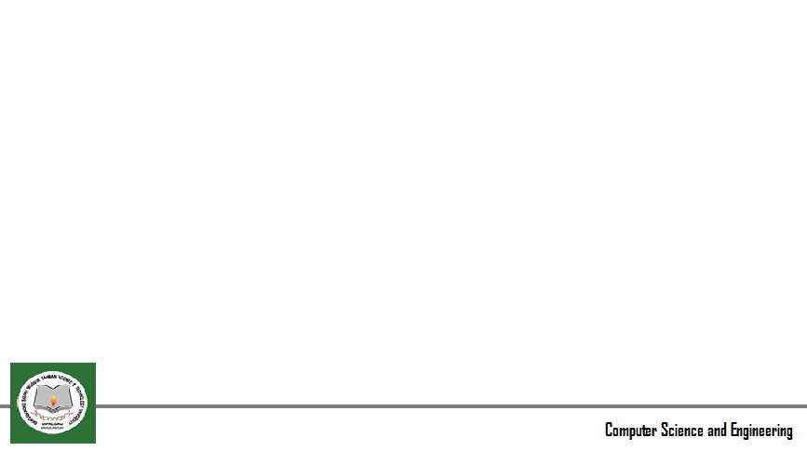
Contents
Introduction
Motivation
Related Works and Limitation
Objective
Methodology
Implementation
Conclusion & Future work
References

Slide 3
Introduction
Information and communication are two of the most important strategic issues for the success of every enterprise , organization or public sources.
Computer networks allow the user to access remote programs and remote databases either of the same organization or from other enterprises or public sources.

Slide 4
Motivation
Client-server architecture, architecture of a computer network in which many client (remote processors) request and receive service from a centralized servers (host computers). Client computers provide an interface to allow a computer user to request services of the server and to display the results the server returns
A client computer can perform many tasks, such as services on the devices as listed (dhcp, dns, mail, web, ftp).

Slide 5
Previous Work and Limitation
This paper describes a new line of enquiry on which we are embarking at Oxford Brookes University. The general motivation for the work is to explore whether Active Networks offer solutions to the scalability issues which beset conventional approaches to the construction of Large-..
The researchers developed a client-server based application called OpTel Billing System (OBS) using Java NetBeans and TCP datagram to demonstrate the concepts of socket programming and its communication in a distributed computing. Interface design, socket programming style, java classes, and exceptions are also considered in the development stage.

Slide 6
Goal (objectives)
1. Physically connect all of the devices(computers) with appropriate cables,
2. Configure IP addressing on all of the networking devices (follow the device labels)
3. Configure the server services on the devices as listed (dhcp, dns, mail, web, ftp)
4. Test your server services using the client computers

Slide 7

Methodology
Block Diagram
Phsically connected devices
Configure IP addressing
Configure the server services
DHCP
DNS
Mail
Web
FTP
DHCP Client
DHCP Client

Slide 8
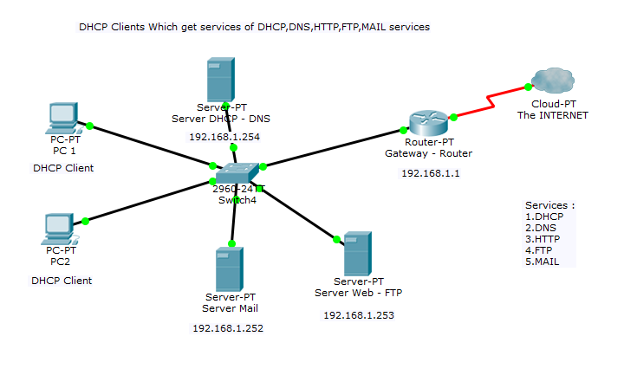
Implementation
Flow chart
Network Demonstration in Cisco Packet traser

Slide 9
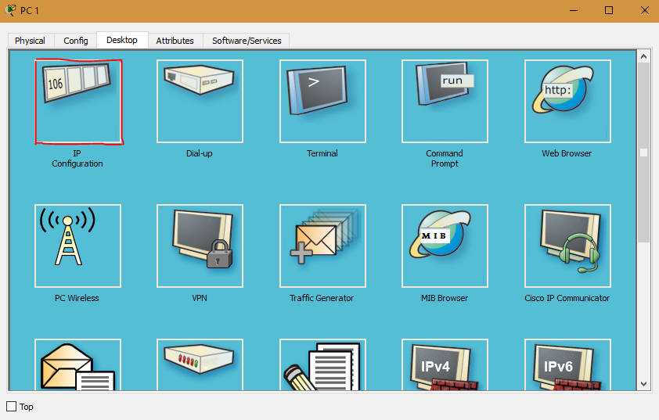
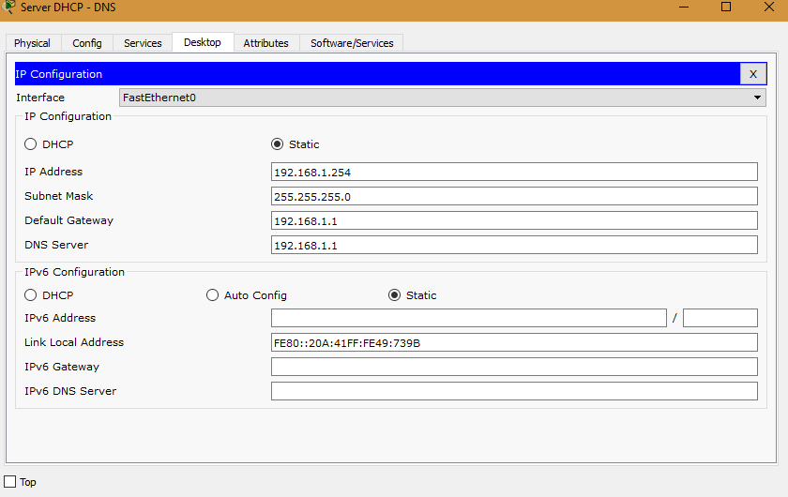
IP Configure
Flow chart
Pc -1 Desktop services
DHCP server

Slide 10
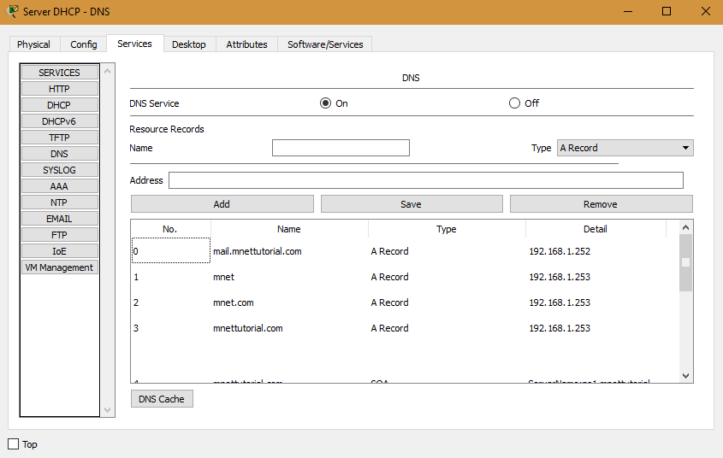
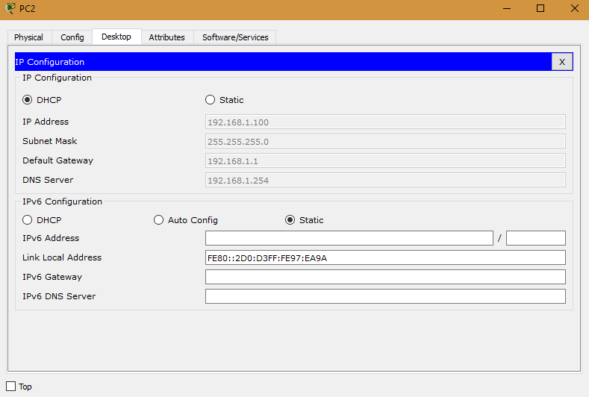
Dhcp & Dns server services
Flow chart
Pc -1 is got the Dynamic Ip address
DNS server

Slide 11
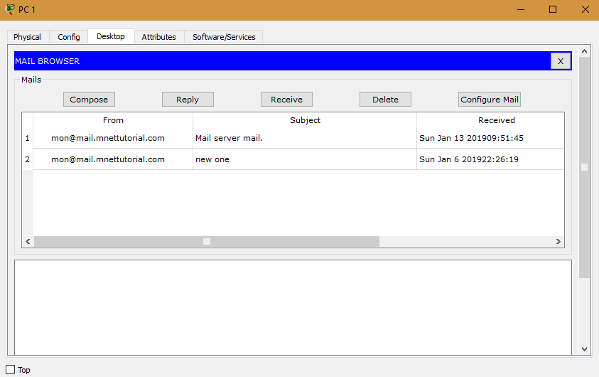
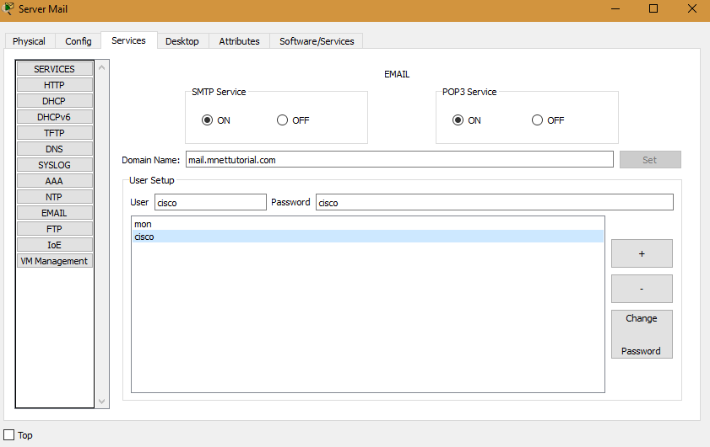
Email Server Services
Flow chart
Pc -1 sending mail
Mail -Server

Slide 12
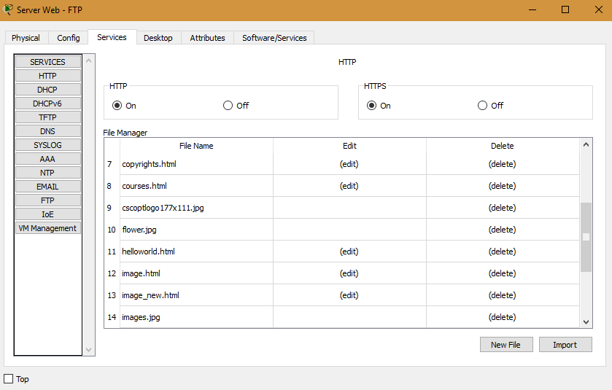
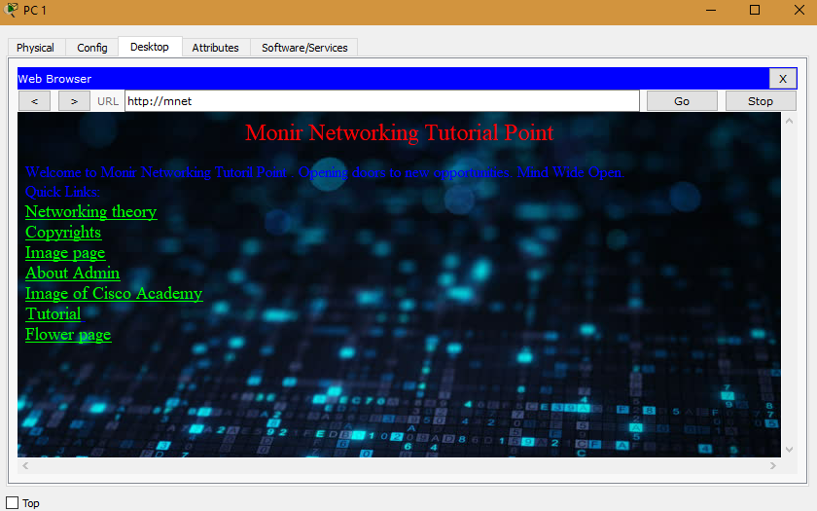
Web Server Services
Flow chart
Pc-1 browses the web server
Web server

Slide 13
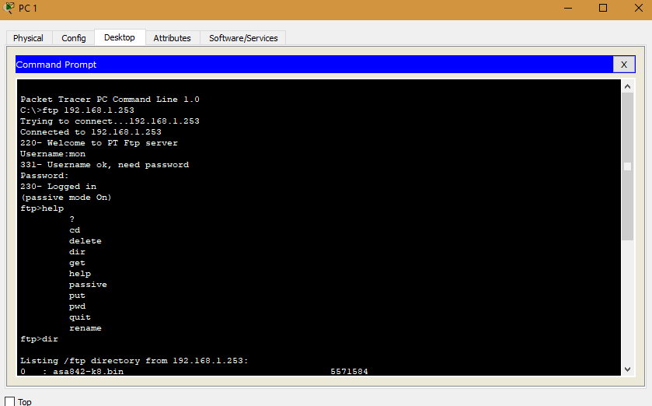
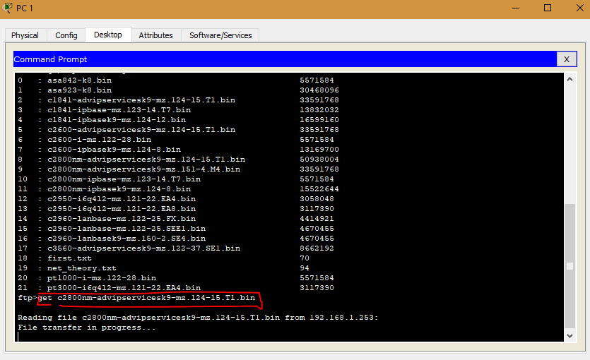
FTP Server Services
Flow chart
For downloading file (accessing) from ftp server
Pc-1 is conneted to the ftp server
Pc-1 downloading file from ftp server

Slide 14
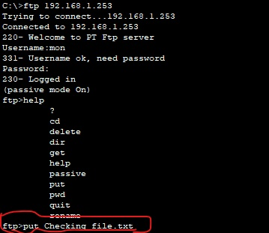
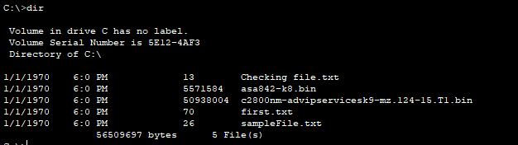
FTP Server Services
Flow chart
For Uploading file (accessing) to ftp server
Pc-1 virtual C drive
Pc-1 uploading a file to ftp server

Slide 15
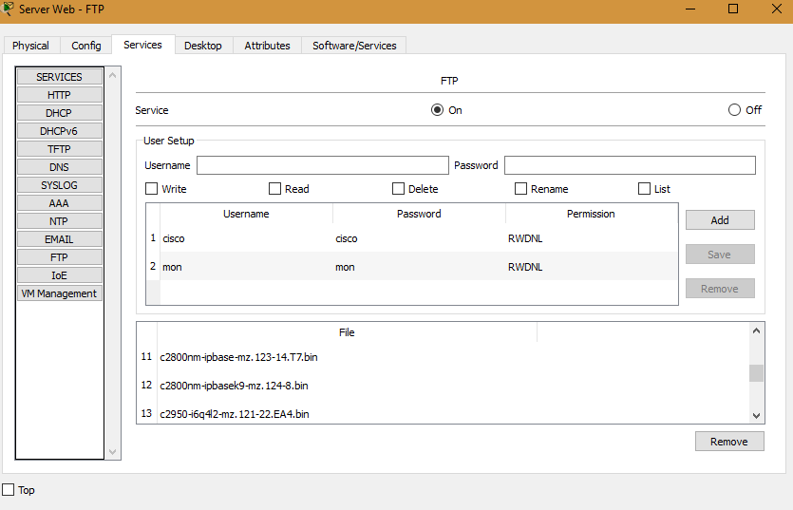
FTP Server Services
Flow chart
Ftp server

Slide 16
Conclusion & Future work
Many clients can access the server’s information download and upload at the same time, a client computer can perform other tasks, such as sending e-mail,Web Browsing etc.
In future I will publish a thesis paper related to this topic.

Slide 17
Reference
[1] Dimik Academy, youtube link https://www.youtube.com/user/DimikComputing/playlists
[2] http://www.danscourses.com/CCNA-1/application-layer-pt-server-activity
[3] https://www.youtube.com/danscourses
[4] https://www3.nd.edu/~cpoellab/teaching/cse40814_fall14/networks
[6] https://www.geeksforgeeks.org/basics-computer-networking/

Slide 18
Thanks All

